Slide 1
Built continues phase change prediction
The way I built the test library:
fraction0 as initail condition, the model will do
1: fraction1=model(fraction0 ,T0,P0) and
From i to i+1: fraction_i+1=model(fraction_i ,T_i,P_i)
And get accumulate error in the end
I have no idea how to create a transformer model, so I just rebuild the library of tabnet as the original one

Slide 2
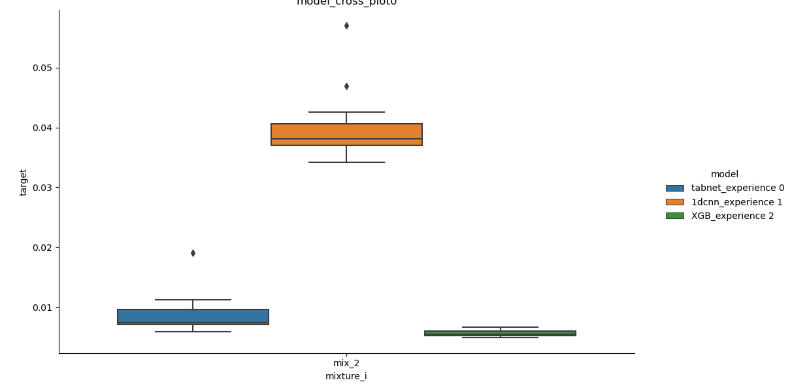
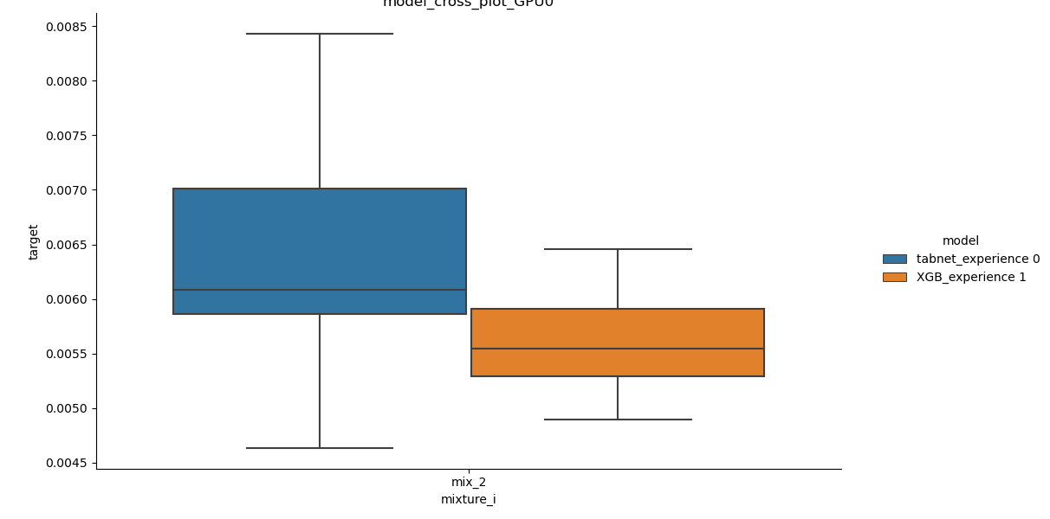
When increase training epoch, tabnet can be more accuracy and to XGBoost
I haven’t test the limitation of this way, I will do it in the next week

Slide 3
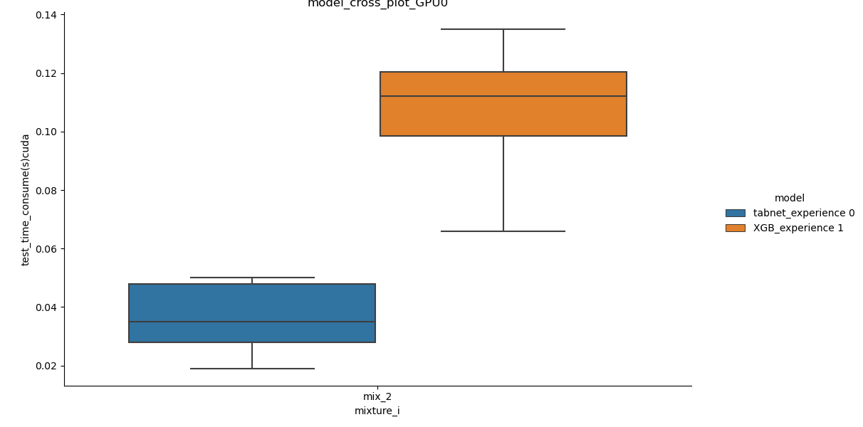
Test time between XGB and tabnet

Slide 4
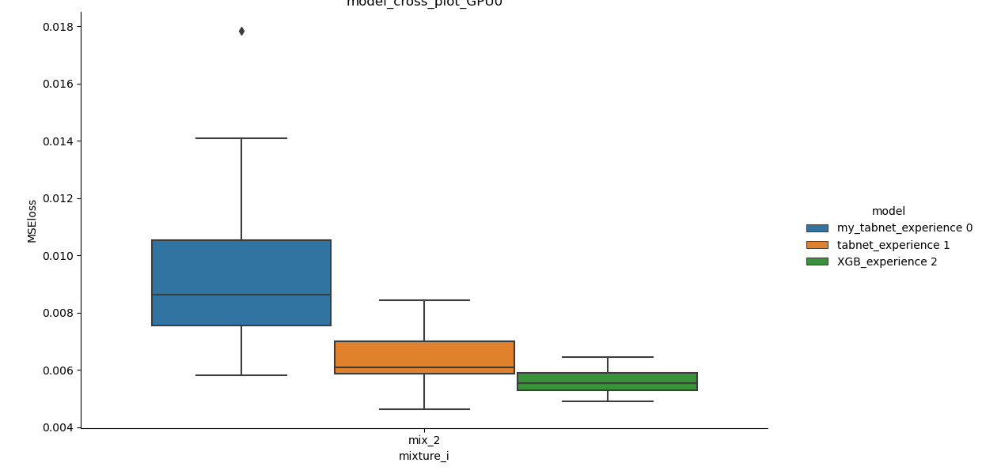
MSEloss between XGB and tabnet in pytorch and my tabnet

Slide 5
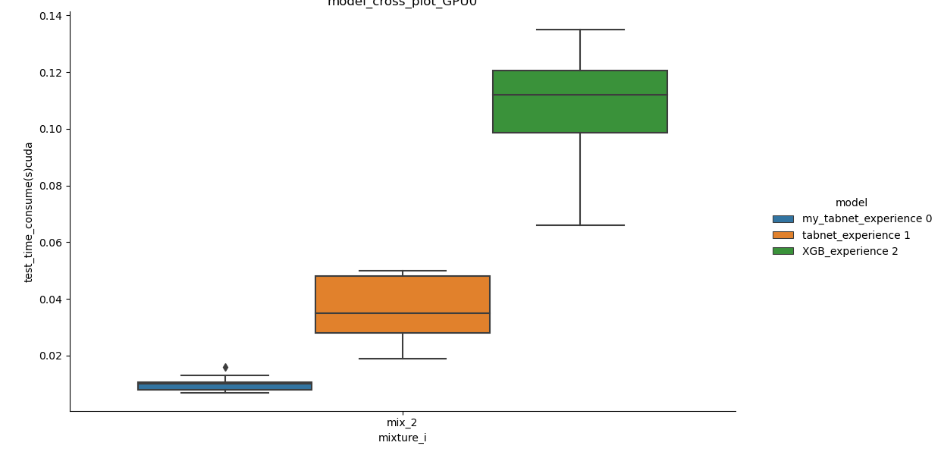
Test time between XGB and tabnet in pytorch and my tabnet

